Slide 1
Optilver predict stocks volatility
EDA & regression

Slide 2
The mission
Predict realized volatility of stock prices in 10 min time buckets
The result is intended as an input for another machine that trades options on these stocks, but that is not a part of this project
Optilver provides samples of book data she collects, and trade data on the same time buckets
The mission is to extract trade signals from the previous time bucket in order to predict the future volatility

Slide 3
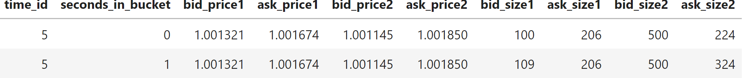
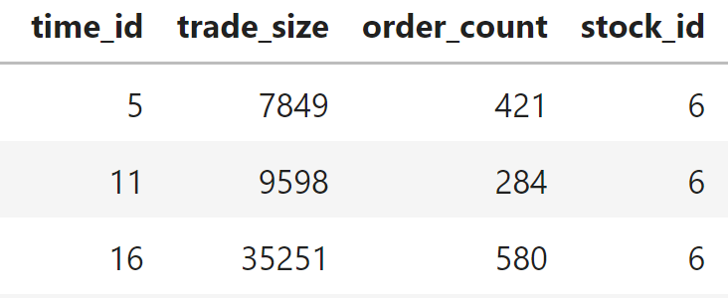
The Data
Book data:
Trade data:
2 files per stock, with approximately 2M records per stock, 112 stocks. 19GB in total

Slide 4
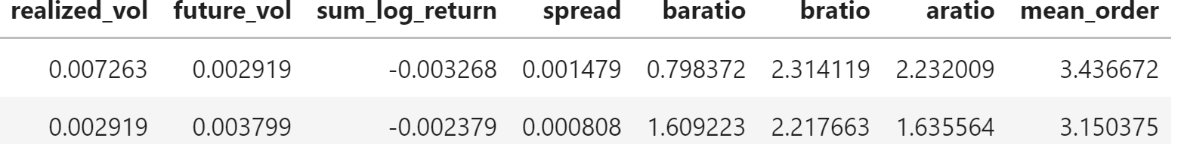
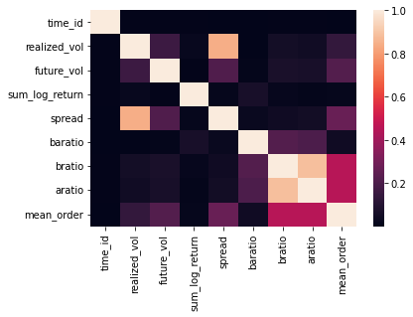
The pipeline
All the features had to be collected from the data. Since the target is in a time bucket - stock level, all the features are aggregations of the data on a time bucket level.
Some features had to be transformed (mostly logged+1 to avoid large negative numbers) due to large tail distributions
Outliers had removed both on target and some of the features
The final dataset:
The correlated features were dealt with when necesery

Slide 5
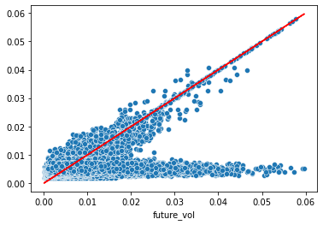
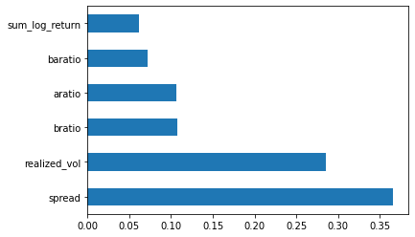
Decision Tree - max_leaf_nodes=1000
Performance of DT model: R2 score: 0.141, RMSPE: 1.009
Predicted VS Actual Features importance
3 models were run. Linear Regression, KNN with various n_neighbors, and Decision Trees with various max_leaf_nodes.
The best results yet were with the DT with 1000 leafs.
The model still predicts a lot of numbers that realize a 0’s.

